Slide 1






Accident Risk & Severity Prediction
AI and Machine Learning Concepts
Supervisied by
Dr. Walaa Elashmawy

Slide 2





Team Memebers
Marwa Ashraf
Nada Shady
Dina Ali

Slide 3



Introduction
ACCIDENT!
Project Beneficiaries
🚑 Emergency Services
Prioritize response using severity prediction and risk scoring to reduce response time and improve survival rates.
🏥 Emergency Medical Services (EMS) & First Responders
Optimize ambulance allocation, improve dispatch efficiency, and prepare medical teams based on predicted accident severity and geographic risk levels.
Using large-scale accident data from Kaggle across the United States, this project generates insights that support safer roads and better decisions.

Slide 4



Introduction
🚦 Road Safety Authorities
Identify high-risk locations and improve infrastructure.
🩺 Hospitals & Trauma Centers
Anticipate incoming critical cases, allocate ICU beds efficiently, and improve emergency preparedness using real-time risk insights.
🏙️ Urban Planners & Policy Makers
Design safer transportation systems using data-driven decisions.
🚗 Drivers & Society
Increase awareness and reduce accident risks through better understanding of dangerous areas and conditions.

Slide 5

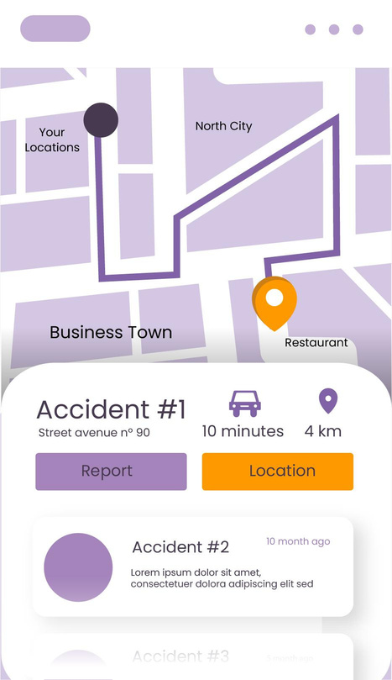

Problem Statement
REPORT!
Road accidents cause injuries, deaths, and economic losses.
Authorities often rely on historical reports rather than predictive analytics.
Limited understanding of accident patterns hinders proactive prevention measures.
There is a need for a system that transforms raw accident data into actionable insights to improve road safety and reduce accident risks.

Slide 6

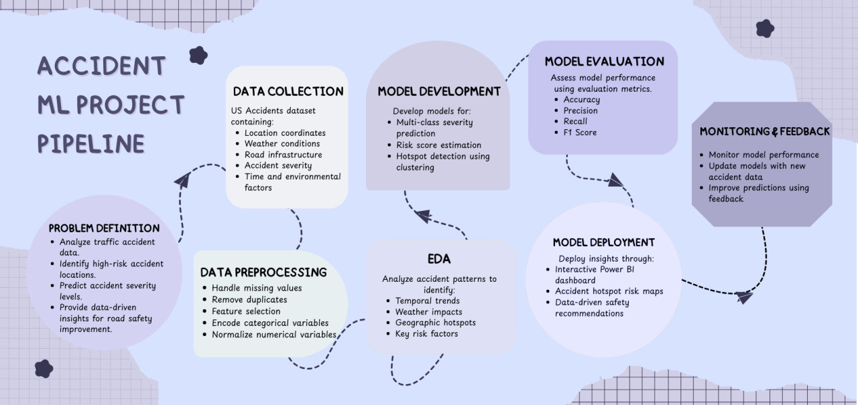

System Overview

Slide 7




Data Used
ACCIDENT!
The analysis is based on the US Accidents Dataset from Kaggle, which contains more than 7 millions of accident records across the United States. The dataset includes information on location, weather conditions, road infrastructure, and accident severity, enabling pattern analysis and predictive modeling.

Slide 8





Feature Used
Feature | Description
Start_Lat / Start_Lng | Geographic coordinates indicating the exact location of the accident.
Severity | The severity level of the accident, typically categorized into multiple levels.
Weather_Condition | Weather conditions at the time of the accident (e.g., rain, fog, clear).
Visibility | The visibility distance at the accident location.
Temperature | Temperature recorded at the time of the accident.
Traffic_Signal | Indicates the presence of traffic signals near the accident location.
Road Conditions | Information about road characteristics and environmental factors that may influence accident occurrence.

Slide 9

Data Preprocessing
Check duplicates
Drop un necessary columns
Handling Missing Values
Encoding
Feature Engineering
Handling Outliers
Standardization
EDA and Extracting Insights
Over sampling

Slide 10






Model(s) Used
XGboost
CatBoost
Neural Network
LightGBM

Slide 11


Training Setup
Train/test split
Tools used (Python, Scikit-learn, pandas, Matplotlib)
Hyper parameters Tuning
Kaggle Environment

Slide 12

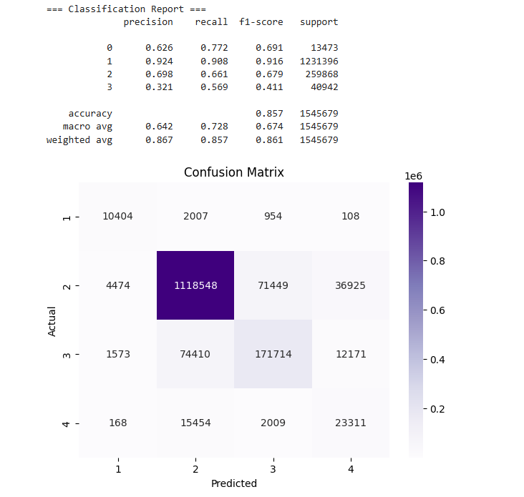
Results

Slide 13
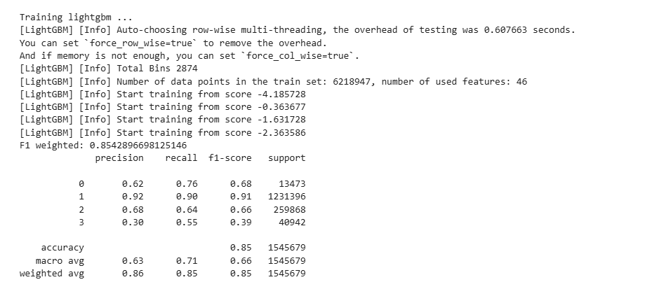
Results-lightGBM

Slide 14
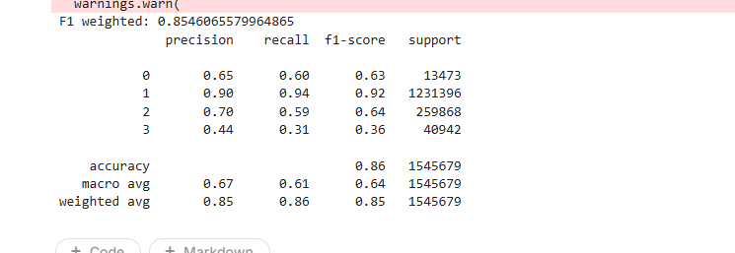
Results-NN

Slide 15
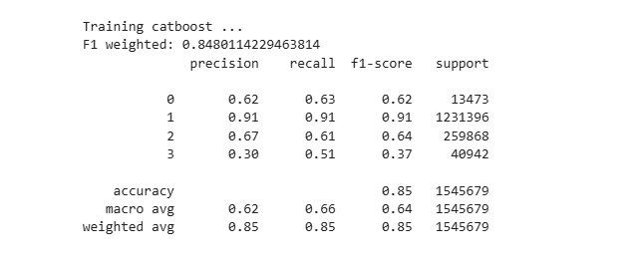
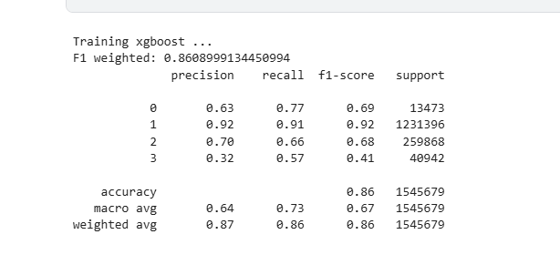
Results-XGboost&Catboost

Slide 16
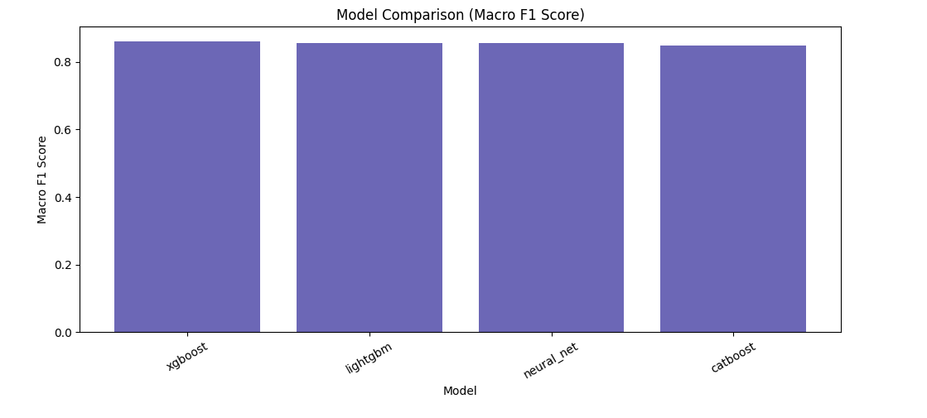
Results-Model Comparison

Slide 17
limitations
Missing data in weather or road conditions
Model accuracy depends on historical patterns
Geographic bias in dataset coverage
Lack of Real-Time Information
Driver Behavior Data

Slide 18


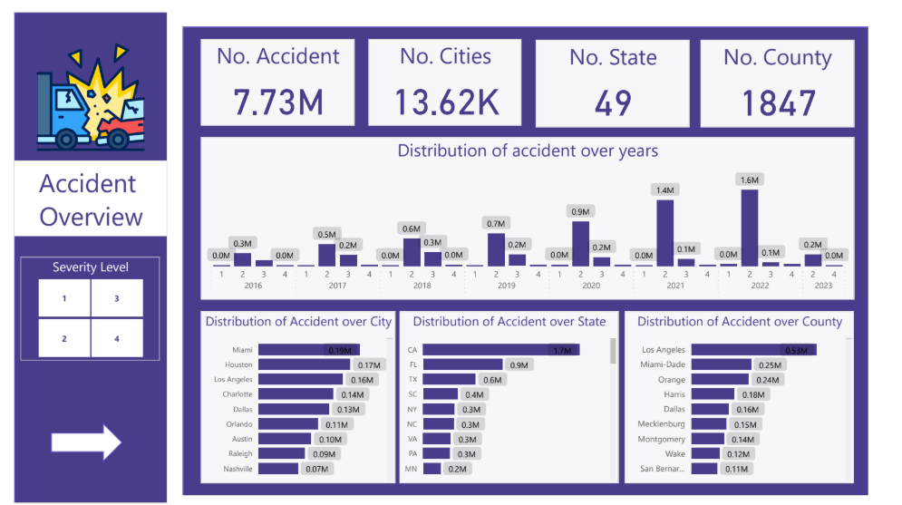
Insights

Slide 19
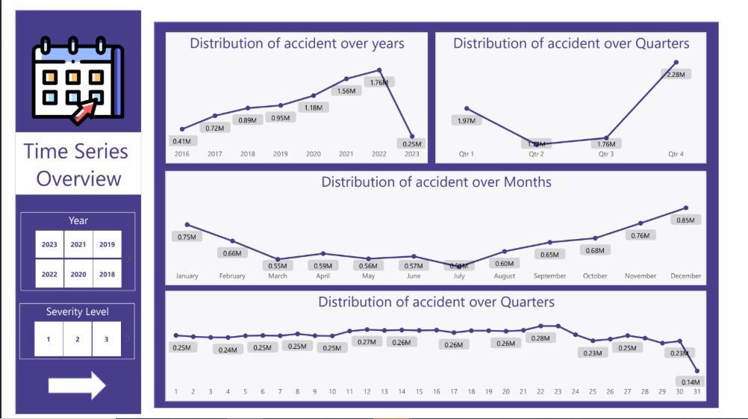
Insights

Slide 20
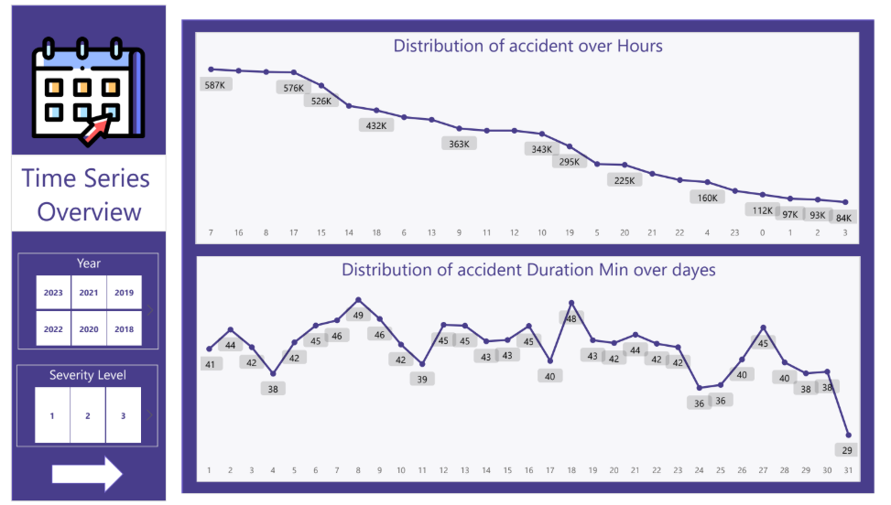
Insights

Slide 21
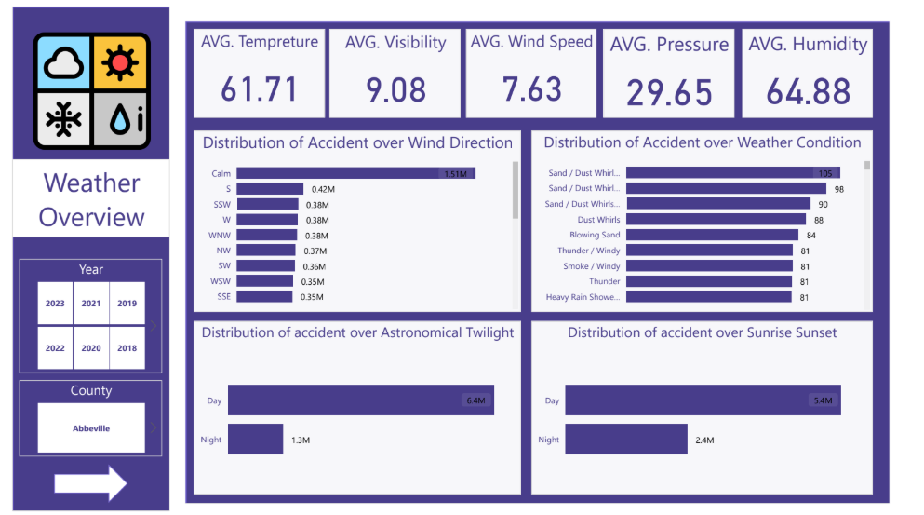
Insights

Slide 22
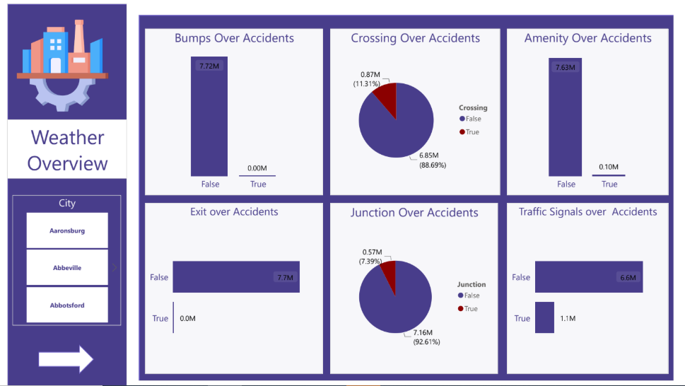
Insights

Slide 23




Future Work
Step 1
Step 2
Integrate real-time traffic data
Use deep learning models
Step 4
Step3
Develop live traffic risk monitoring system
Integrate Driver Behavior Data

Slide 24








Individual Work
Nada
Sharable Works
Data Collection &
Preprocessing Modeling
Data Exploration
Report
Marwa
Encoding & Modeling
Data analysis Dashboard
Dina
Preprocessing Modeling& Presentation

Slide 25


THANKS!

